Slide 1
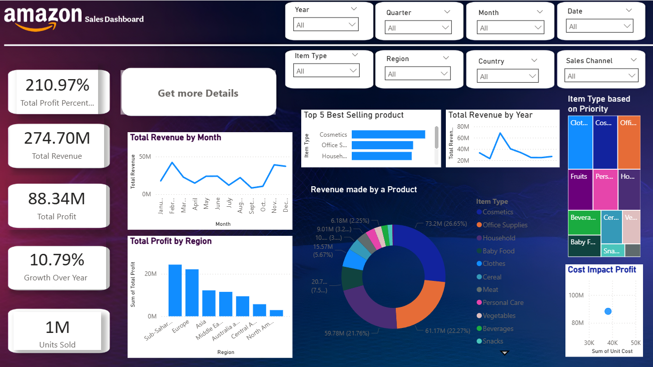
Interactive Sales Dashboard for Business Stakeholders
Tool: Microsoft Power BI
Dataset: Amazon Sales Data (from GitHub)
Objective:
Build an interactive dashboard to track Sales, Profit, and Growth.
Help business stakeholders make data-driven decisions.
Key Features:
Cleaned and transformed data in Power Query
Added KPIs, Filters, and Time-Series Analysis
Designed with consistent theme and cards for summary

Slide 2

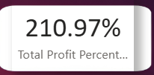
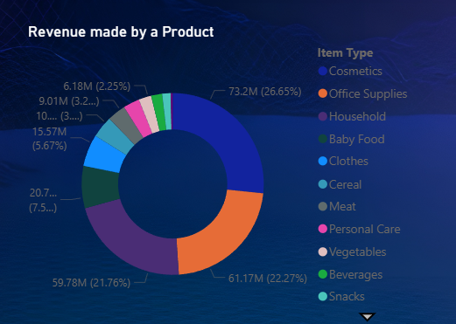
Visuals Used
Cards: Total Sales, Profit, Margin, Quantity
Line Chart: Sales/Profit over Time
Bar Chart: Profit by Region
Pie Chart: Sales by Category
Top N Bar Chart: Best-Selling Products
Scatter Plot: Discount vs Profit
Slicers: Region | Category | Month
Key Insights:
Highest profit from South Region
Technology category leads in revenue
Profit dips with >10% discounts
Steady growth across months (≈8–10%)
Top Products: Laptops, Chairs, Mobiles
Made Navigation

Slide 3
Business Impact:
Clear visibility into performance trends
Improved profit tracking and decision support
Real-time filtering for stakeholder analysis
Next Steps:
Automate data refresh (GitHub/SharePoint)
Add forecast and customer segmentation
Expand visuals for quarterly reporting
Tools Used:
Power BI, Power Query, GitHub CSV
CSV link : https://github.com/jicsjitu/Analyzing_Amazon_Sales_Data?utm_source
📘 Name and role:
Presented by: Sanket Tele – Data Analyst

